Slide 1

NET Theragnostics-1
Prof John Buscombe

Slide 2
Introduction
The idea of using somatostatins
Single photon imaging: In-111 and Tc-99m including using SPECT-CT
PET: Ga-68 DOTATATE
PET newer tracers and ideas

Slide 3
The start: [¹²³I]I-Tyr-octreotide
Basel team noted the octreotide localised to SSTR2 on a range of NETs¹
Eric Krenning working with Reubi²
  First used [¹²³I]I-Tyr-octreotide
  Found tumours in 3/4 GEP NET tumours and 2 meningiomas in which it was tested, was negative in 1 Insulinoma and also 3 MCT and an ACC
However, I-123 not easy chemistry and tended to dissociate from cells¹
  Instead, In-111 used via a DTPA linker

Slide 4
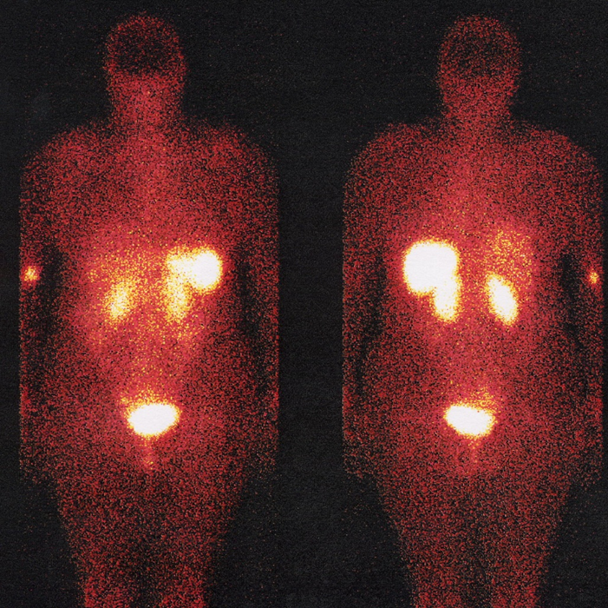
In-111-DTPA octreotide
Rotterdam group lead by Eric Krenning
Use of DTPA linker
On peptide chain away from receptor binding site
Normal distribution spleen, liver, kidneys, urine and variable gut
By 1993 published over 1000 cases

Slide 5

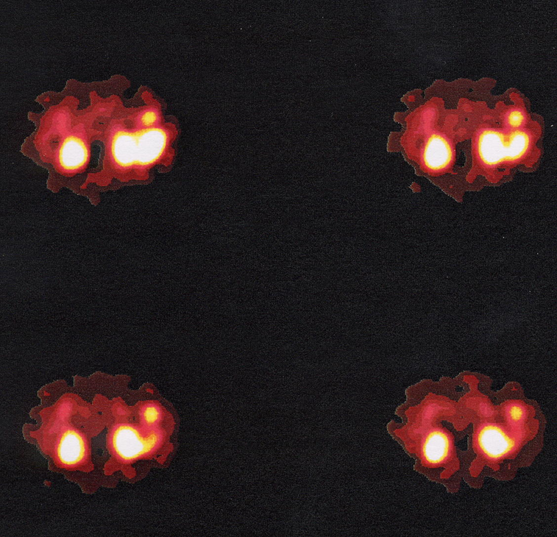
Planar vs SPECT In-111 pentreotide imaging
Small pancreatic tail tumour

Slide 6
SPECT-CT in somatostatin imaging
The next step
Because uptake can be localised more precisely
Specificity improved
Localisation may help identify tumour sites for surgeons eg sentinel node
Generally cheaper than PET

Slide 7
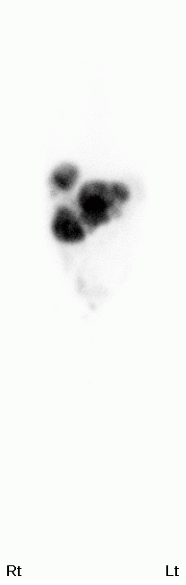
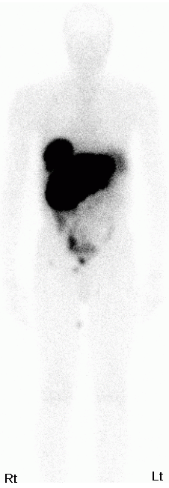
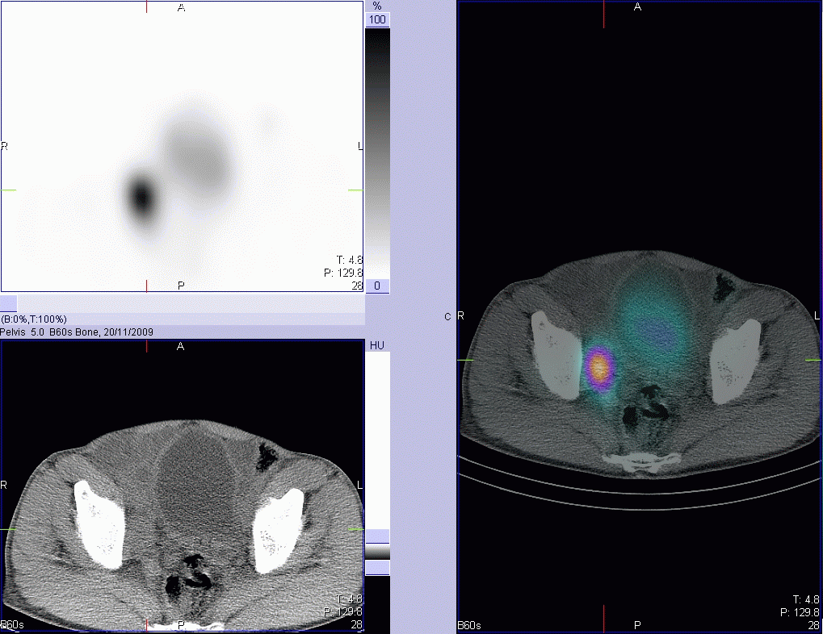
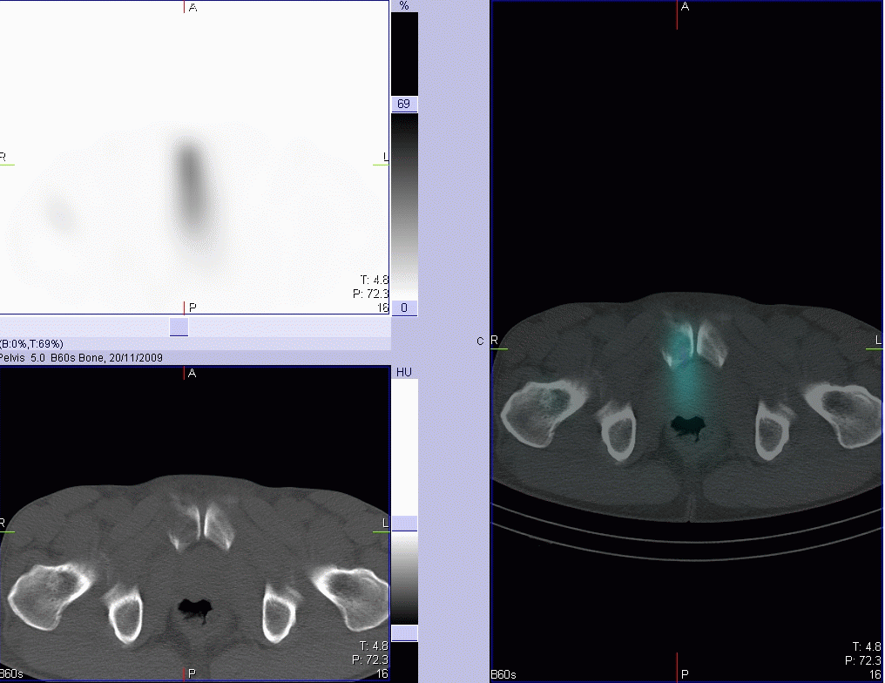
SPECT/CT: improved localisation with hybrid imaging may increase sensitivity
In-111 pentetreotide
Courtesy of Dr Navalkissoor
Notes:
In recent years hybrid imaging has been shown to be of value. As you know, iit is now not possible to purchase a PET only scanner, they are all PET/CT. These images are from our new SPECT CT camera, courtesy of one of our specialist registrars Dr Navalkissoor who is presenting a paper looking at the improved specificity from using SPECT alone versus SPECT/CT.
On this study you can see pelvic uptake on the WB, with uptake clearly localising to an obturator node and to the right pubic symphysis that is associated with bony destruction.

Slide 8
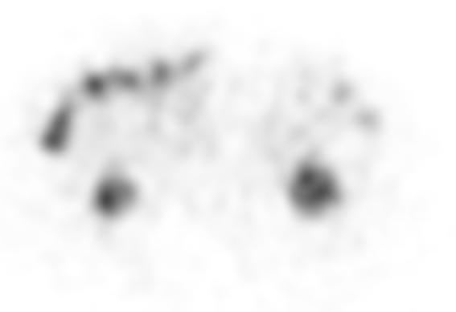
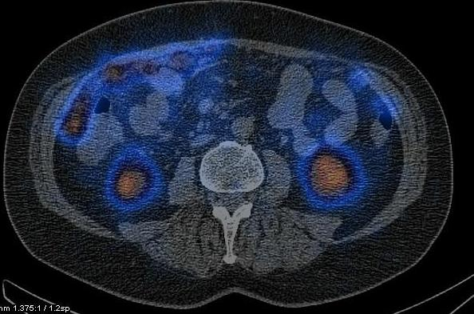
SPECT-CT improves specificity
Is this colonic activity
On SPECT-CT its actually peritoneal mets
In-111 Pentetrotide

Slide 9
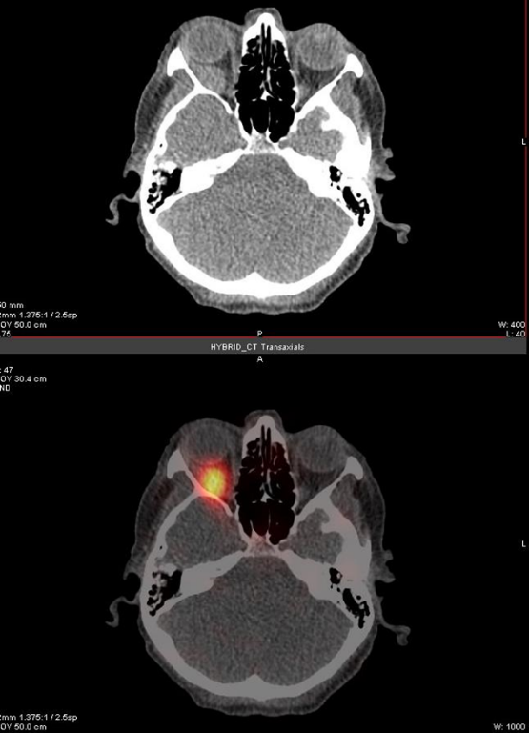
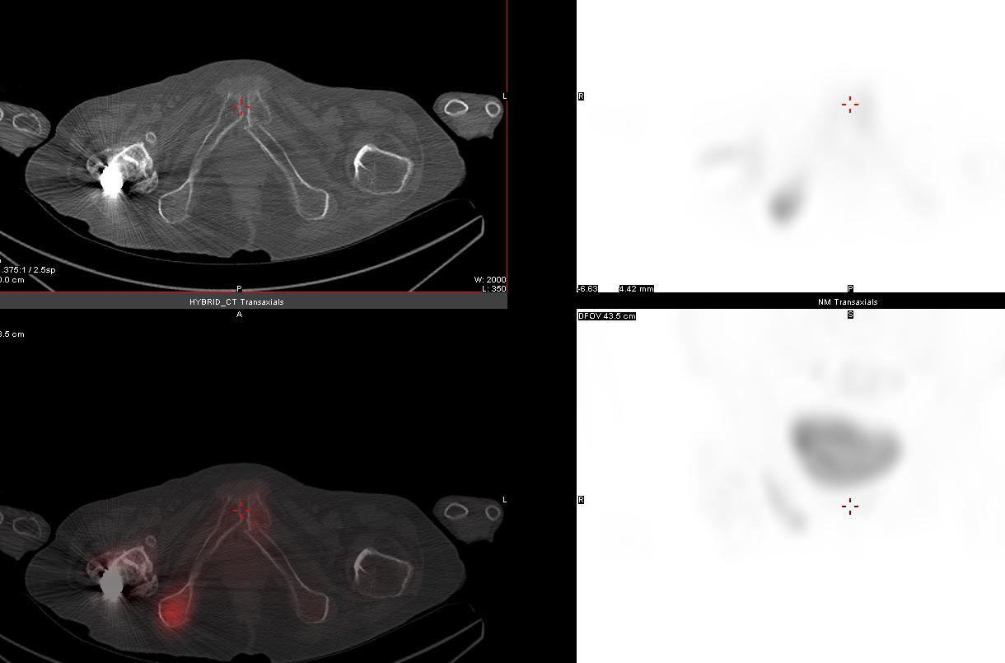
Finding unexpected disease
In-111 pentreotide finding unexpected sites of metastatic NETs

Slide 10
Wong et al Acad Radiol 2010
49 patients compared SPECT In-111 octreotide with SPECT/CT
28% of lesions identified as pathological on SPECT were shown to be due to physiological uptake on SPECT/CT
SPECT/CT changed patient management in 24% of patients compared to 14% with SPECT
Mainly due to improved confidence in reporting

Slide 11
Perri et al QJNM 2009
Assessed accuracy of SPECT vs SPECT/CT in 169 lesions in 81 patients imaged with In-111 pentetreotide
Site of disease | SPECT | SPECT-CT
Overall | 46% | 94%
Liver | 83% | 100%
Lung | 74% | 100%
Pancreas | 0% | 67%
Gut | 40% | 93%
Lymph nodes | 3% | 85%
Bones | 34% | 100%

Slide 12
Tc-99m HYNIC TATE
Based on octreotate higher SSR-2 affinity
Tc-99m linked via nicotinic acid linker
Increased uptake in SSR2 positive tumours
Much cheaper
Lower radiation dose
Now widely available
May provide solution of Ga-68 DOTATATE not available

Slide 13
NEN/NET –midgut - carcinoid
Male 64 years old no previous history of cancer;
From last year diarrhoea and flushing, from 3 months a significant increase severity in symptoms;
Previous evaluation for irritable bowel syndrome (-);
In ultrasound (US) numerous focal lesions metastatic type within the liver;
On CT - number of focal lesions in the liver, hipervscular mts type, no primary lesion seen on initial CT scan;
Liver Bx liver - NETG2 (Ki-67=5%) - moderately differentiated neuroendocrine tumors (carcinoid) metastases.

Slide 14
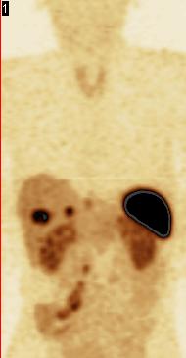
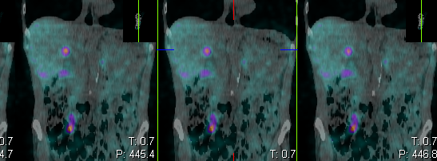
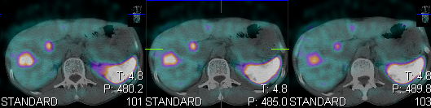
Liver metastases
Primary tumour, small bowel NETG2 and local lymph nodes
Involvement. pT4N1M1, CS IV.
Liver metastases

Slide 15
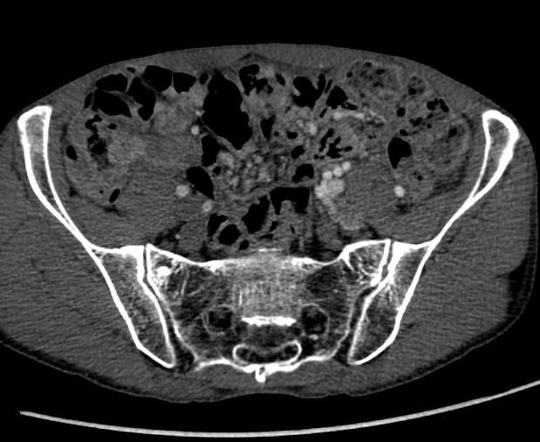
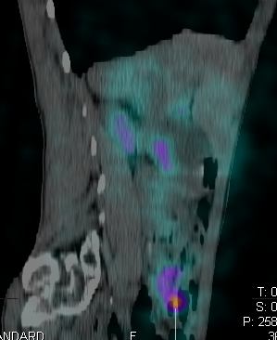
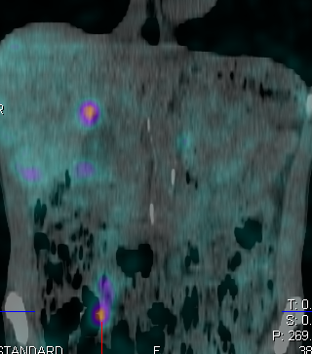
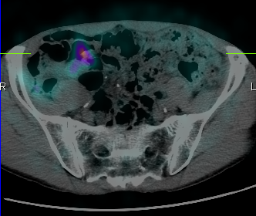
On Contrast enhanced CT no definitive pathology, seen in small bowell.
In SRS focal increase of radiotracer uptake in small bowel tumour. Surgery and pathology confirmed NETG1 (Ki-67<2%,) s2.5 cm tumour, In addition multiple liver metastases seen showing high ^{99m}Tc HYNICTOC (Tektretyde) uptake.
Primary in small bowel
NETG1 Ki-67<2%

Slide 16
Can we improve on SPECT-CT
Normally we would look at PET
However, G1 and G2 NETs do not normally have uptake of FDG
Attempts to make F-18 DOTATATE have not worked well
For peptides radiometals work better than halogens which have a large charge and disrupt the peptide chain
Need PET emitting metals

Slide 17
What is Ga-68 DOTATATE
Ga-68
  Short lived daughter of Ge-68
  Therefore generator produced
  Half life 68 minutes
  Positron emitter
DOTA
  Linker molecule
TATE
  Alcoholised somatostatin analogue
  Very high affinity for SSR2 (10x-100x octreotide)

Slide 18
Ga-68 somatostatins
Since 2001 Ga-68 somatostatins used in NET and brain primaries
Work centred on Hanover, Heidelburg and Basel
84 patients imaged with Ga-68 DOTATATE and In-111 pentetreotide JNM 2007 from Innsbruck
Sensitivity 96% compared with 65% with In-111 pentetreotide

Slide 19
Comparison of In-111 pentetreotide with Ga-68 Dotatate PET /computed tomography uptake patterns in patients with Neuroendocrine tumours R Srirajaskanthan, J Bomanji, A-M Quigley, I Kayani, ME Caplin, JCO 2010
SCAN APPEARANCE | N=44
both studies positive, Ga-68 more lesions | 18
both studies positive, In-111 more lesions | 1
both studies similar lesions | 7
pos Ga-68, negative In-111 | 11
pos In-111, neg Ga-68 | 0
both studies negative | 7

Slide 20
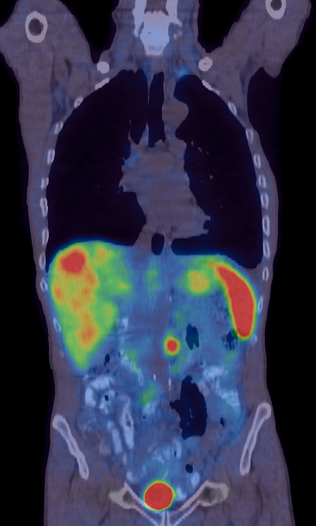
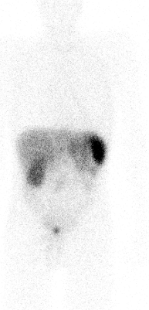
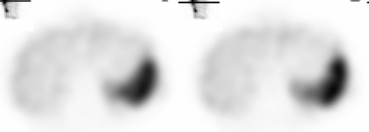
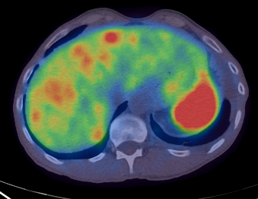
Ga-68 PET/CT more lesions than
In-111 Oct
In fact 11% of patients negative of In-111 octreotide are positive on Ga-68 DOTATATE
In-111 Oct WB
Ga-68 PET/CT
SPECT

Slide 21
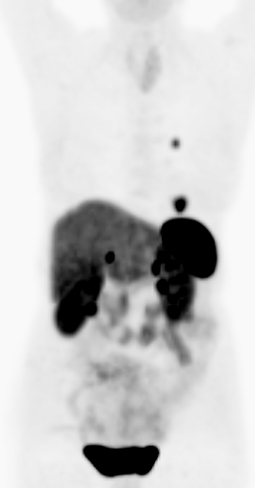
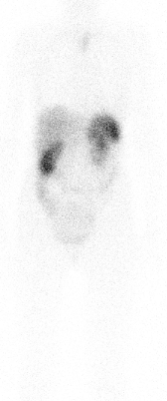
Ga-68 PET/CT pos In-111 Oct neg
Ga-68 PET MIP
In-111 Oct WB

Slide 22

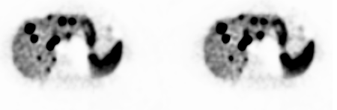
Ga-68 PET/CT more lesions than In-111 Oct
In-111 Oct
Ga-68 PET

Slide 23
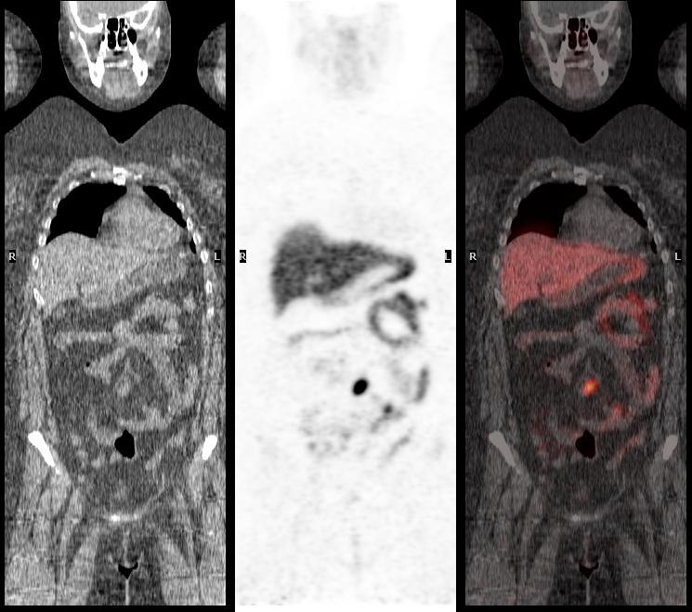
Ga-68 DOTATATE-small primary

Slide 24
Ga-68 DOTATATE in Pancreatic NET
Normally expect uptake of Ga-68 DOTATATE OR F-18 FDG
However in 18 pts Kayani et al (JNM 2005) showed uptake of both
However more false positives with F-18 FDG
Recommend use of Ga-68 DOTATATE
?Co-existent cancer

Slide 25
Ga-68 DOTATATE in MTC
Compared with FDG in MTC
Conry et al EJNM 2010
18 patients with raised calcitonin
  13 positive with Ga-68 DOTATATE
  15 postive with F-18 FDG
More sites of disease seen with FDG
Recent work suggest Ga-DOPA FDG

Slide 26
Ga-68 DOTATATE vs In-111 octreotide phase III trial data
Deppen et al JNM 2016
Multi-centre trial 78 patients with NETs imaged with In-111 octreotide and Ga-68 DOTATATE
 | Sensitivity | Specificity
In-111 octreotide | 73% | 93%
Ga-68 DOTATATE | 96% | 93%
Ga-68 DOTATATE resulted in a change of management in 28 patients (36%).

Slide 27


FDG vs Ga-68 DOTATATE
Originally thought if one positive other not
However, more complex some NETs of foregut origin can be positive with both agents
Beware up to 20% of NET patients can also have a cancer
F-18 FDG
SSR imaging
More benign More malignant

Slide 28
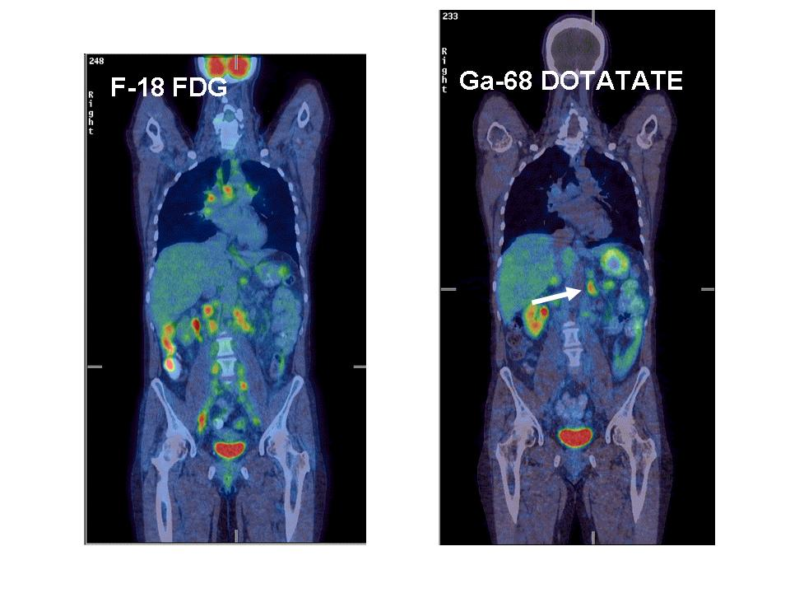
F-18 FDG measure metabolism and Ga-68 DOTATATE receptor activity
Same patient imaged with both tracers. NET unknown origin
Biopsy of F-18 FDG lesion shows Ki67 of >10%.
Biopsy of Ga-68 DOTATATE positive lesion Ki-67 1%
Patient responding to FCIST
Buscombe BMB 2012

Slide 29
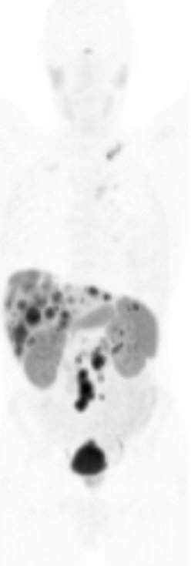
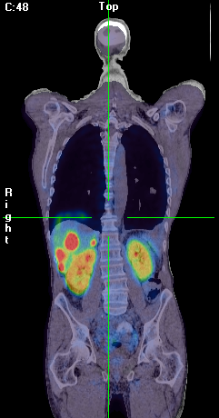
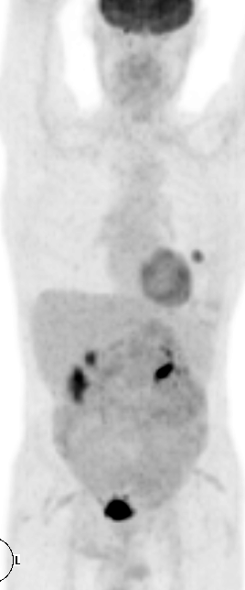
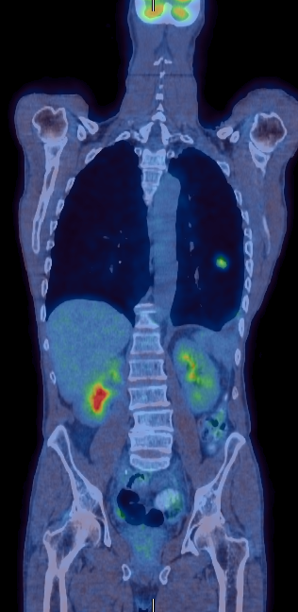
Midgut NET what does this mean?
New lung lesion:
Not avid on Ga-68 DOTA-octreotate
Lung Lesion: avid on FDG
Notes:
In this second patient, there are multiple hepatic and abdominal tracer avid foci on the Ga 68, but the new lung lesion only showed tracer uptake on the FDG, with no uptake in the liver.
A squamous cell lung carcinoma was found on biopsy.

Slide 30
Compared to CT/MR
Very little prospective evidence
Best series Schmid et al EJNMMI 2013
Looked at 18 patients with pNET
Compared MRI and Ga-68 DOTATATE
MRI sensitivity by lesion 63%
Ga-68 DOTATATE sensitivity by lesion 100%

Slide 31
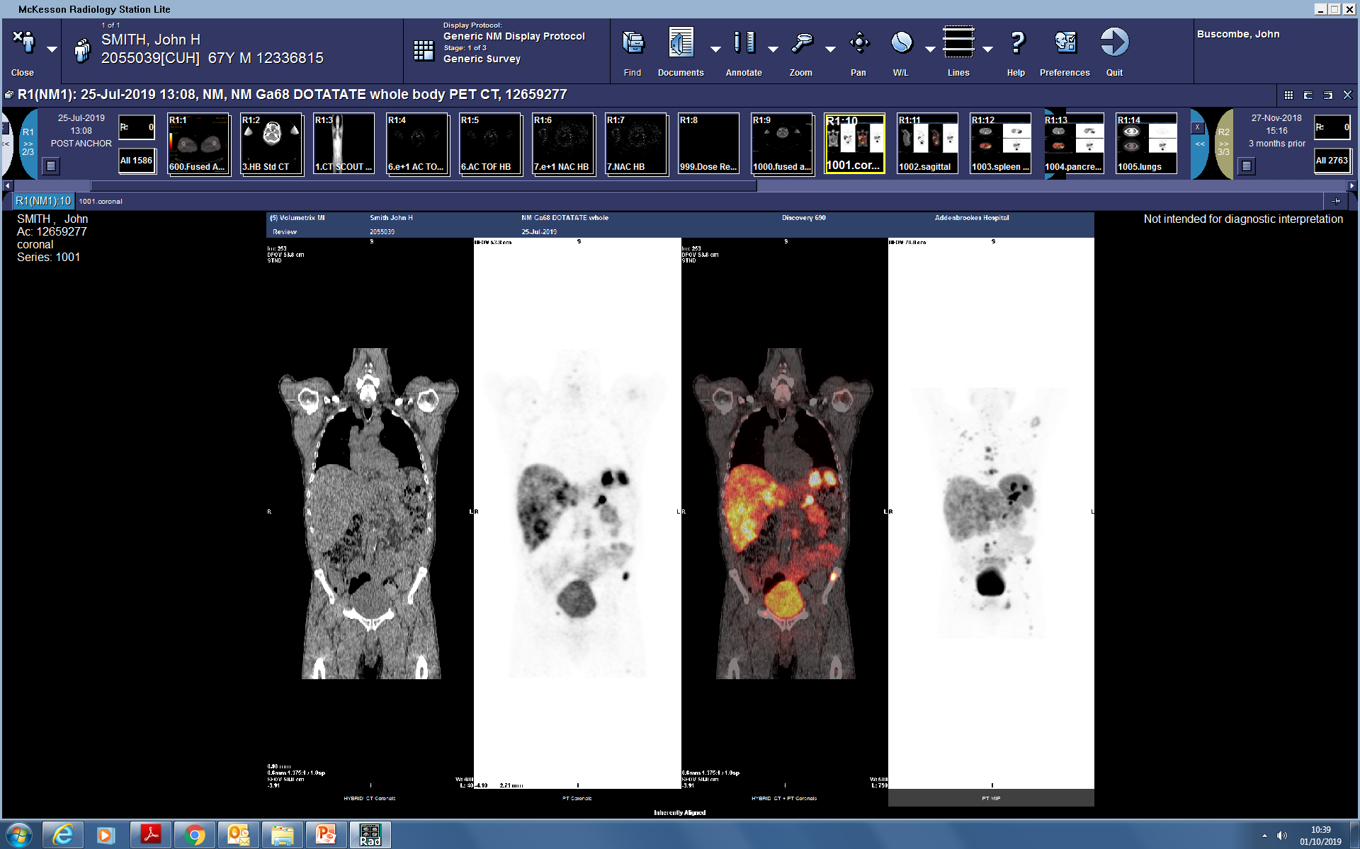
Whole body Ga-68 DOTATATE PET of patient with metastatic small bowel NET

Slide 32
Theragnostics
One of main uses of Ga-68 DOTATATE/DOTATOC PET is to decide on whether to give PRRT
Need to have uptake in known tumour sites greater than normal liver to recommend therapy
Controversial use to assess the response to therapy

Slide 33
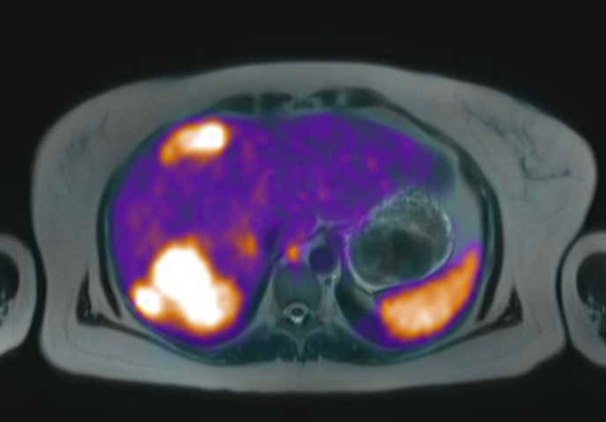
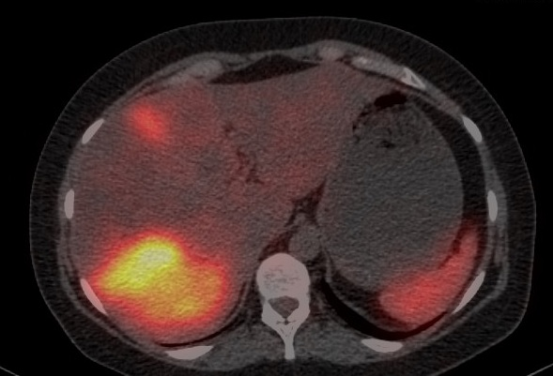
Theranostic pair in ACTHoma
Ga-68 DOTATATE PET-MR Lu-177 DOTATATE SPECT-CT

Slide 34
New ideas in Somatostatin PET
Use of antagonists instead of agonists may improve selectivity
Use of different radionuclides as Ga-68 has such a short half life this includes the use of Copper-64 and F-18. Approved in USA as issues with short T1/2 and long travel times in USA - Pauwels et al Am J NM and Mol Imag 2018

Slide 35
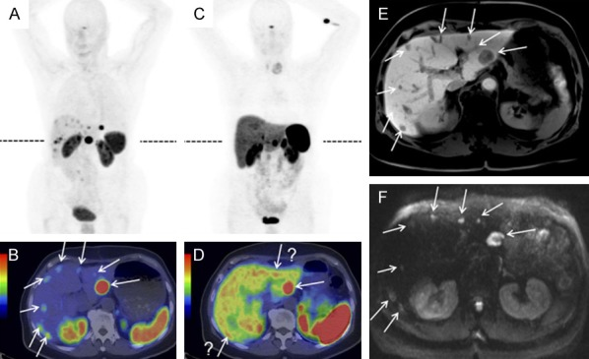
Use of antagonists
Image A and B are from an antagonist Ga-68 J11 compared with a standard Ga-68 DOTATATE scan (Nicholas et al JNM 2018)

Slide 36
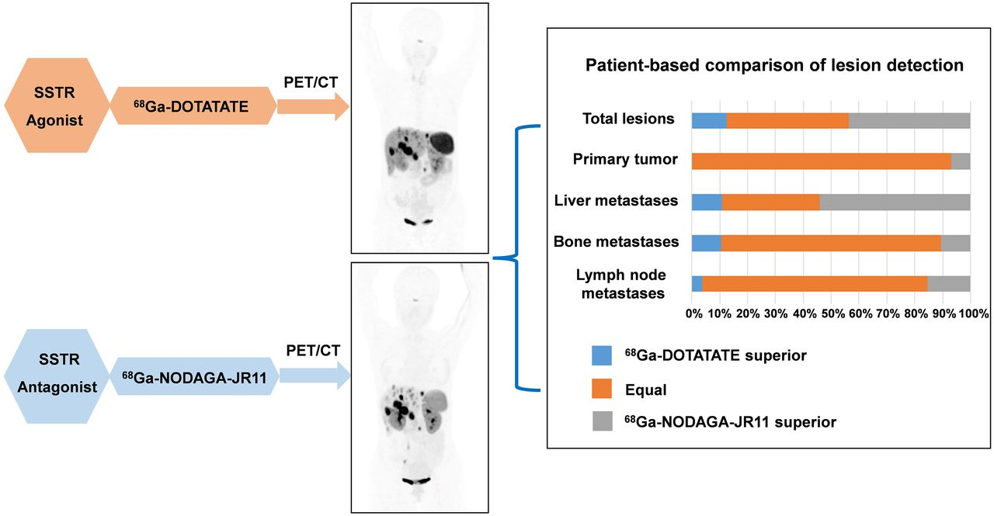
Ga-68 DOTATATE vs Ga-68 NODAGA JR11
Lin Z et al JNM 2023

Slide 37
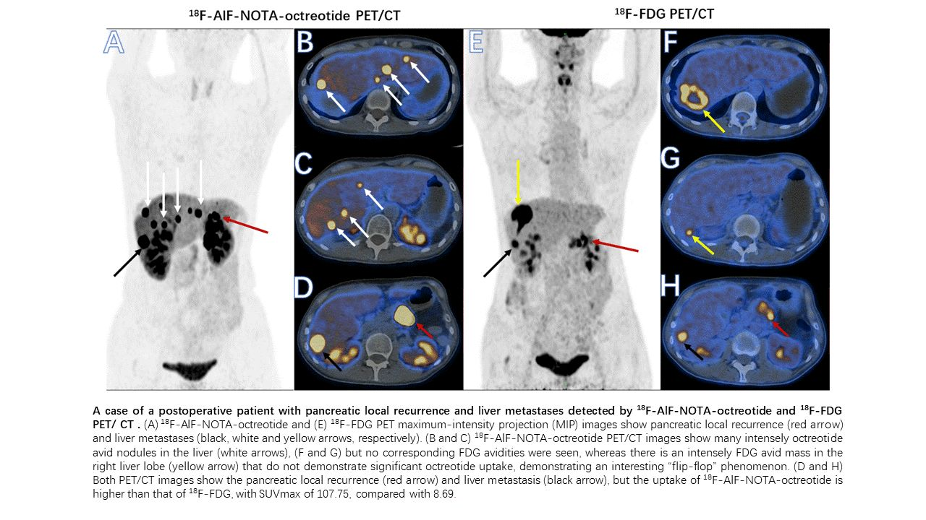
F-18 AIF-NOTA PET
Long et al JNM 2018

Slide 38
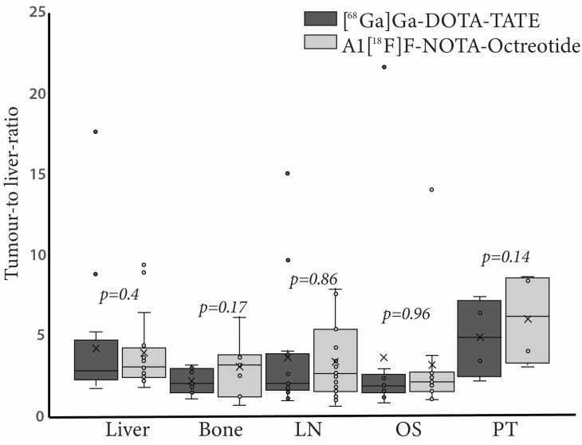
Comparing Ga-68 DOTATATE vs F-18 NOTA-octreotide
Tumour/organ ratio of F-18 NOTA octreotide vs Ga-68 DOTATATE Haeger A et al Chile, Cancers 2023

Slide 39
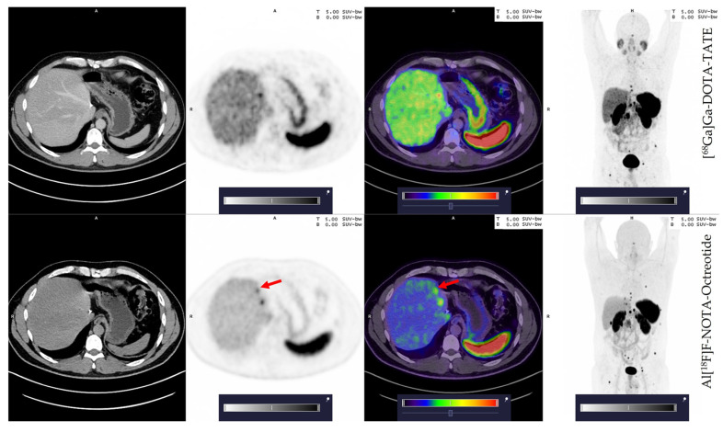
Comparing Ga-68 DOTATATE vs F-18 NOTA-octreotide
42 year old with G2 NET showing better tumour to background uptake in the liver metastases with F-18 NOTA octreotide vs Ga-68 DOTATATE Haeger A et al Cancers 2023

Slide 40
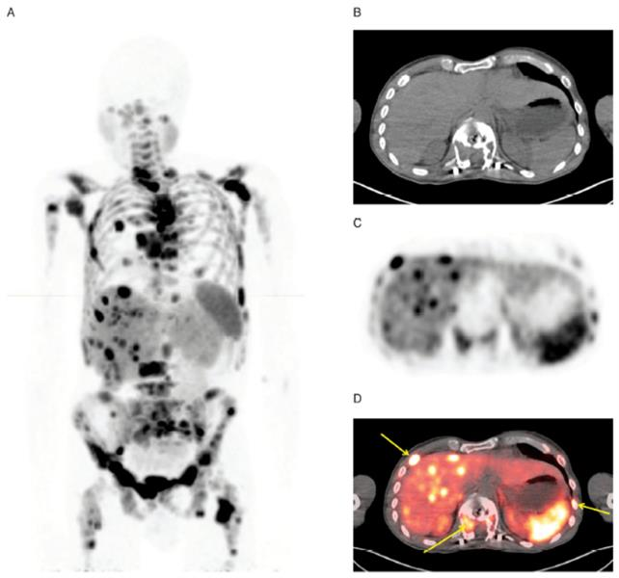
[⁶⁴Cu]Cu-DOTA-TATE (Detectnet™)^{1,2}
Provision of [⁶⁸Ga]Ga- DOTA-TATE is less suited to USA than Europe
  May take 2–3 hours to travel
  across city in the USA
Short T_{1/2} can be an issue
Cu-64 can be complexed to
DOTA-TATE
T_{1/2} 12.7 hours
Worse dosimetry less
of an issue in the USA
Detectnet™ is an unlicensed product in the UK.
[⁶⁸Ga]Ga-DOTA-TATE is an unlicensed product in the UK.
[⁶⁸Ga]Ga-DOTA-TOC is licensed as SomaKit TOC® in the UK.

Slide 41
Conclusions
Somatostatin imaging has a 30 year history
Early use of In-111 octreotide
Then development of a Tc-99m DOTATATE and SPECT-CT
Ga-68 DOTATATE provides best imaging but either PET-CT or SPECT-CT will select patients for PRRT
In G2,G3 tumours consider F-18 FDG PET to look for non SSR expressing tumours
New agents may use different radionuclides and peptides including antagonists

